Slide 1
Introduction
Project Titile: Password Authentication System
Team Members
Name:Promod Chondro Das Name:Chinmoy Debnath
Id: 231002005 id: 231902029
Dept: CSE Dept: CSE
Submitted to:
Md. Romzan Alom

Slide 2
Objectives
Implement a basic authentication system using 8086 Assembly that validates username and password.
Demonstrate the use of DOS interrupts (INT 21h) for handling string output, character input, and program control.
Develop subroutines for input reading and string comparison to mimic secure login functionality.
Enforce login security with limited attempts and provide user feedback through message prompts.

Slide 3
Concepts Used
8086 Assembly Language Programming
Understanding and applying low-level instructions and syntax.
String Handling and Comparison
Manual character-by-character comparison using registers and loops.
User Input Processing
Reading keyboard input using INT 21h, storing and managing input strings.
Replacing typed characters with asterisks (*) during password entry.
Conditional and Loop Control
Using CMP, JE, JNE and loops to manage login attempts.
Leveraging DOS interrupts for displaying messages, reading input, and exiting the program.

Slide 4
Features of the Program
Displays welcome message
Asks for username and password
Compares with hardcoded credentials
Masks password input with *
Allows 3 login attempts
Shows access granted/denied messages

Slide 5
Memory Segments
.data Segment :
Holds messages, credentials, input buffers, and variables.
.stack Segment:
Allocates 100h bytes for function calls and return addresses.
.code Segment:
Contains main program logic and subroutines.
Segment Termination:
The program ends here.

Slide 6
Input Handling
Subroutine: read_input_username
Takes user input character by character until Enter (ASCII 13)
Subroutine: read_input_password
Same as username, but prints * instead of actual character

Slide 7
String Comparison Logic
Subroutine: compare_strings
Compares byte-by-byte until end marker ($)
Sets AL = 0 if match, 1 if not
Essential for validating credentials

Slide 8
Program Flow
START
↓
Display Welcome
↓
login_attempt Loop:
↓
Check Attempts Left
↓
Ask Username → Ask Password
↓
Compare Credentials
↓
├──✓ Access Granted → END
└──✗ Access Denied → Decrease Attempts → Repeat
↓
Attempts = 0 → Lockout → END

Slide 9
Interrupts Used
int 21h for:
AH=09h: Display strings
AH=01h: Read input character
AH=02h: Print character (* for password)
AH=4Ch: Exit program

Slide 10
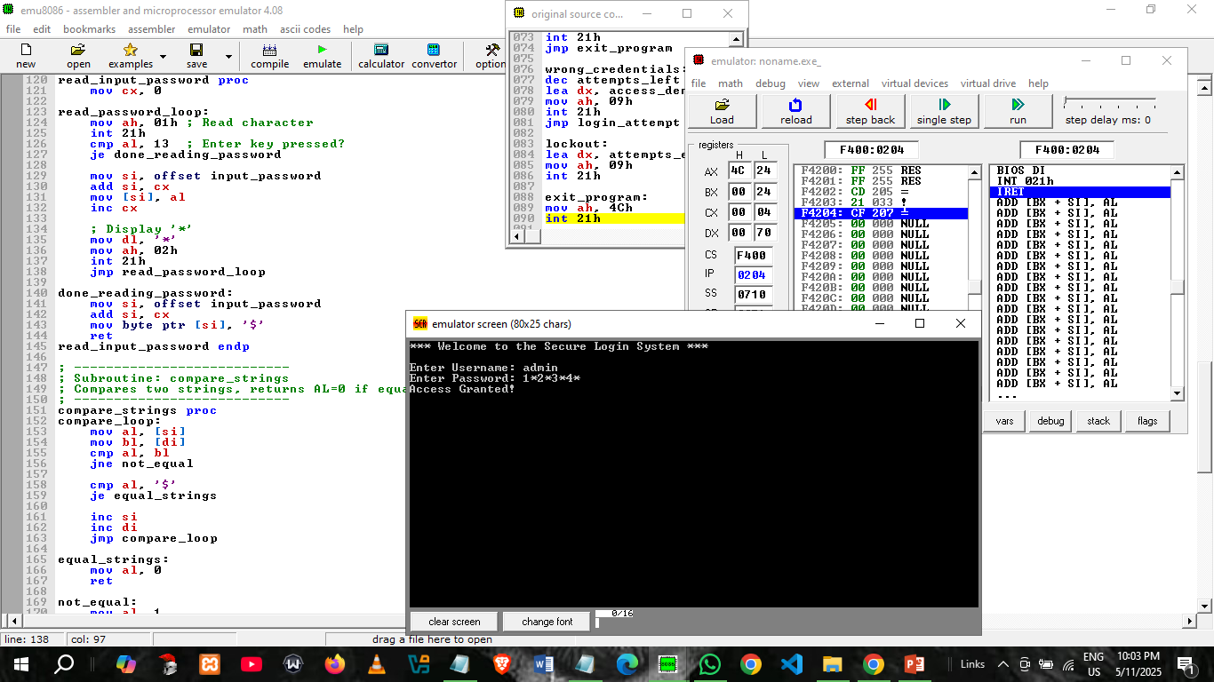
Sample Output

Slide 11
Challenges Faced
No built-in string handling (manual comparisons)
Managing character input and masking
Limited debugging tools in assembly

Slide 12
Future Improvements
Store credentials externally (e.g., in a file)
Use larger database and integrate this authentication sytem with that
Add encryption for password storage
Implement logout or session control
Add user registration support

Slide 13
Conclusion
Successfully implemented a secure login system using 8086 Assembly language.
Demonstrated the power of low-level programming by handling user input, string comparisons, and password masking.
Achieved login attempt control with a limit of 3 retries, enhancing security.
Gained insights into manual memory management, interrupt-based I/O.
The project highlights the importance of optimizing performance and security in low-level applications.

Slide 14

Feel Free to ask questions

